Slide 1

Website: Bikewale.com
Title: Analyzing Indian Motorcycle Trends using BikeWale Data
Name: Prasad.M
Date: 12-08-2025

Slide 2
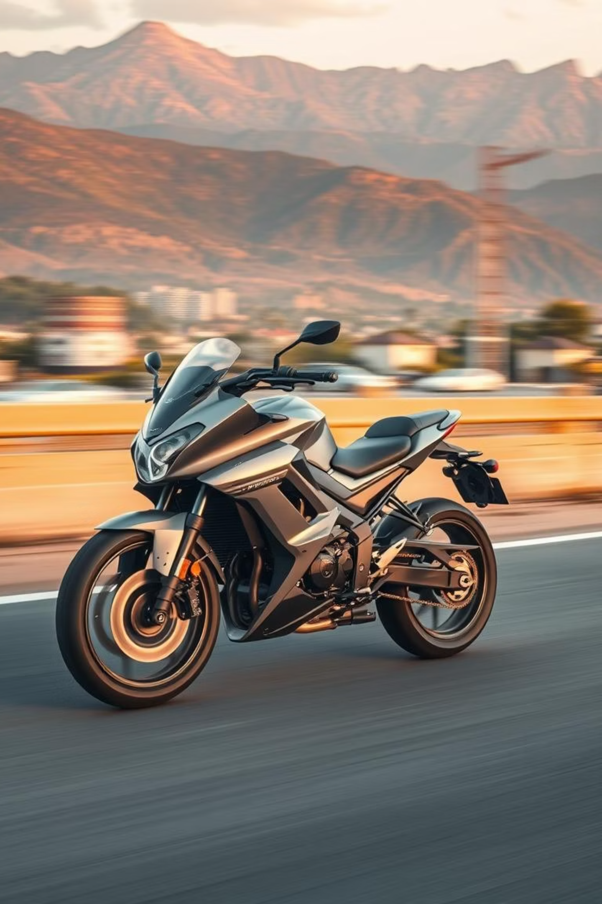
Exploratory Data Analysis of Bike Data
An Analysis of Data Scraped from BikeWale.com

Slide 3
Unveiling the Indian Bike Market
Project Goal:
Data Source & Key Points:
To scrape, clean, and perform an exploratory analysis of "Best Bikes in India" data to uncover key insights into the market dynamics.
Data was meticulously scraped from BikeWale.com, capturing critical metrics for each bike:
Bike Name & Brand
Ex-Showroom Price
Engine Specifications (BHP, CC)
Weight & Mileage
User Ratings

Slide 4
Data Preparation: From Raw to Refined
Initial State
Cleaning Process
Missing Values
Raw, unstructured text data from web scraping presented the first challenge.
Data was loaded into a pandas DataFrame. Numeric columns (Price, BHP, CC, Weight, Mileage) were meticulously cleaned by removing currency symbols, units (e.g., '₹', 'kg'), and other text characters. The number of ratings was extracted, and a 'Brand' column was ingeniously created from the bike names.
Missing 'Mileage' values were imputed with the column's average, ensuring completeness without losing valuable data. All other rows with any remaining null values were carefully dropped.

Slide 5
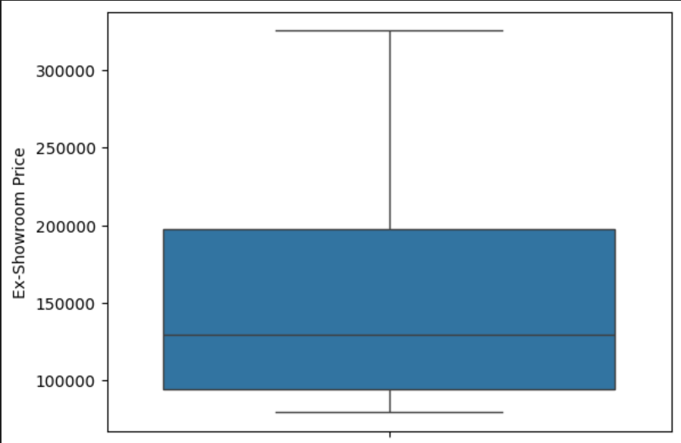
Box Plot of Ex-Showroom Price: Distribution & Outliers
The middle line in the box is around ₹1,30,000, meaning half the bikes cost less than this and half cost more.
The box covers roughly ₹95,000 to ₹2,00,000, which means the middle 50% of bike prices fall within this range.
.The whiskers extend from around80,000 to ₹3,25,000, indicating the overall price spread in your dataset.
There are no points outside the whiskers, so extreme outlier prices aren’t present (based on the standard 1.5×IQR rule).
.

Slide 6
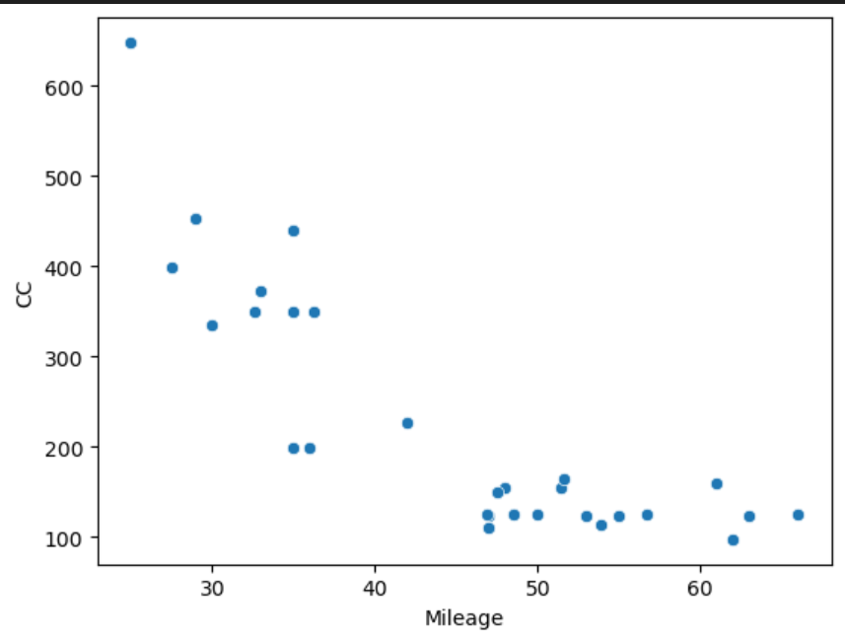
Mileage vs. CC: The Efficiency Trade-off
Most high-mileage bikes (50–65 kmpl) are in the 100–150 CC range.
Larger engines (350 CC and above) generally offer 25–35 kmpl mileage.
There is a clear negative correlation — bikes with higher engine capacity tend to have lower mileage.

Slide 7
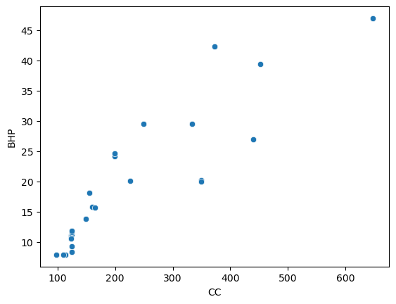
CC vs. BHP: The Power Dynamics
There is a strong positive correlation — higher engine capacity generally produces higher BHP.
Bikes with 100–150 CC engines mostly have 7–15 BHP.
Mid-range engines (200–350 CC) produce around 15–30 BHP.
Large engines (400+ CC) deliver above 40 BHP in some cases.

Slide 8
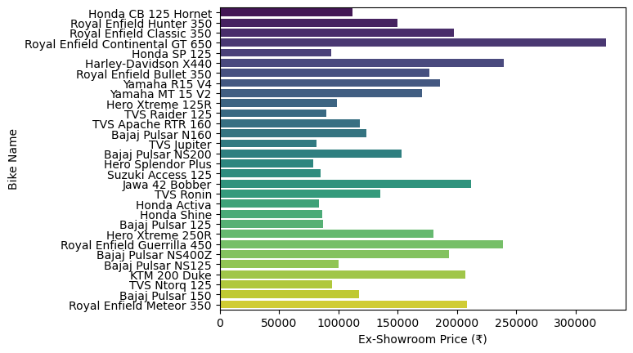
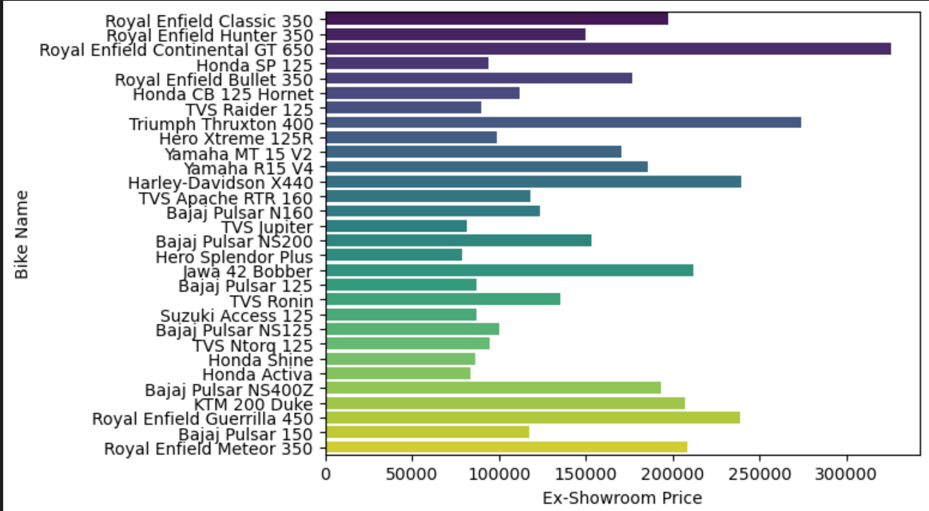
Ex-Showroom Price of Bikes
This horizontal bar plot offers a clear visual comparison of the ex-showroom price for every bike model in our dataset. The length of each bar directly reflects the price, allowing for immediate identification of cost variations across models. The 'viridis' color palette adds a visually appealing gradient from yellow to purple, enhancing readability and engagement.

Slide 9
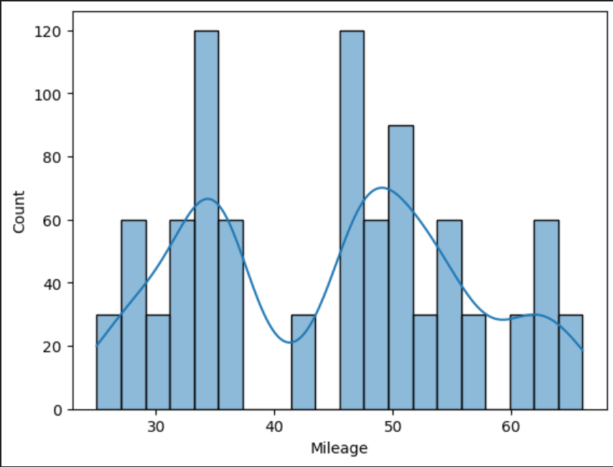
Mileage (kmpl) Distribution: Common Ranges
Mileage values range from 25 kmpl to 65 kmpl.
Two major peaks are visible:
Around 35 kmpl (lower-mileage group)
Around 48–50 kmpl (higher-mileage group)
A smaller cluster exists around 60+ kmpl.
Distribution is bimodal, indicating two popular mileage segments in the dataset.

Slide 10
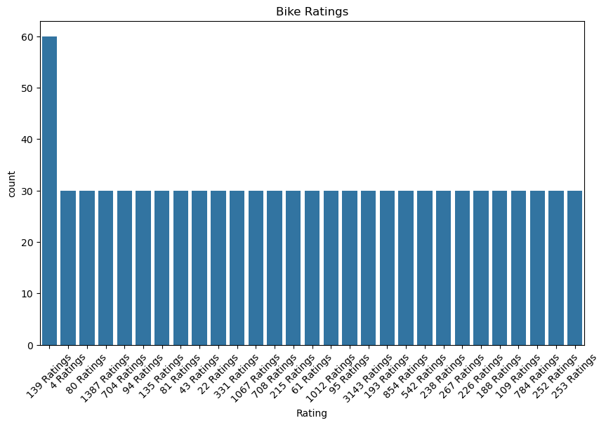
Bike Ratings Count: Understanding User Sentiment
This count plot visually represents the frequency of each unique rating value within our dataset. The bars are thoughtfully ordered by frequency, ensuring that the most common rating categories are immediately apparent. This chart is instrumental in understanding how many bikes have garnered a specific number of user ratings, providing a quantitative perspective on user engagement and overall bike popularity on BikeWale.com.

Slide 11
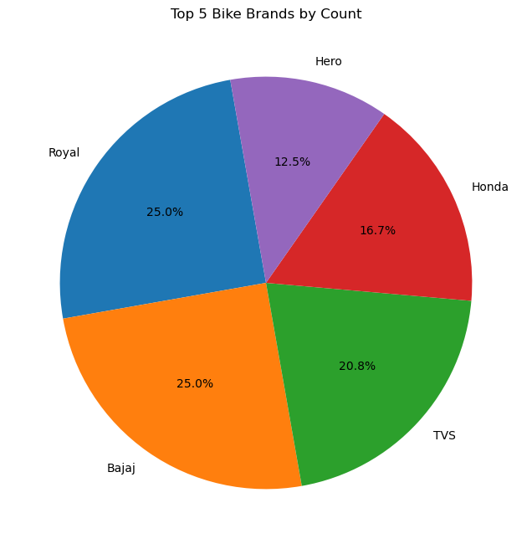
Market Share of Top Bike Brands
Top 5 Bike Brands by Count
This pie chart displays the market share of
the top 5 bike brands based on the number
of models in the dataset.
Each slice represents a brand, and the size
of the slice corresponds to its percentage
of the total.
The chart shows that Royal Enfield and Bajaj
each have 25% of the models among the
top 5 brands.

Slide 12
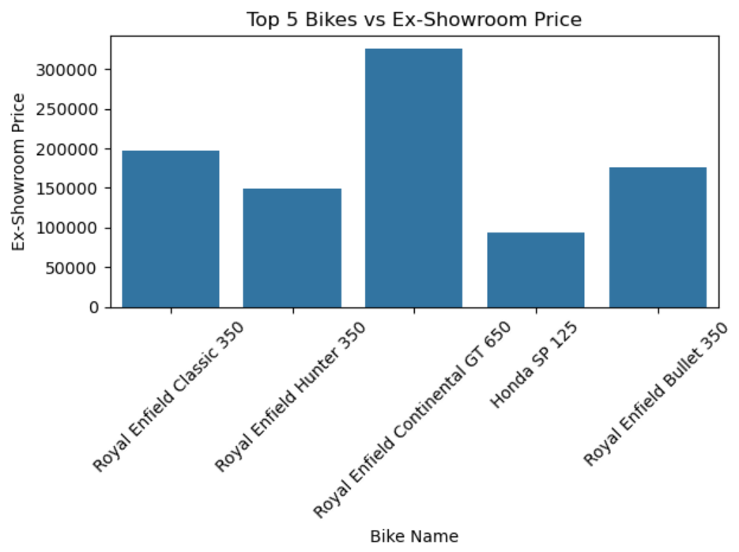
Price Comparison of Top Bikes
Top 5 Bikes vs Ex-Showroom Price:
This bar plot shows the ex-showroom price for the first five bikes listed in the dataset.
The bike names are displayed on the x-axis, and their corresponding prices are on the y-axis.
This provides a quick visual comparison of the price points for these specific models.

Slide 13
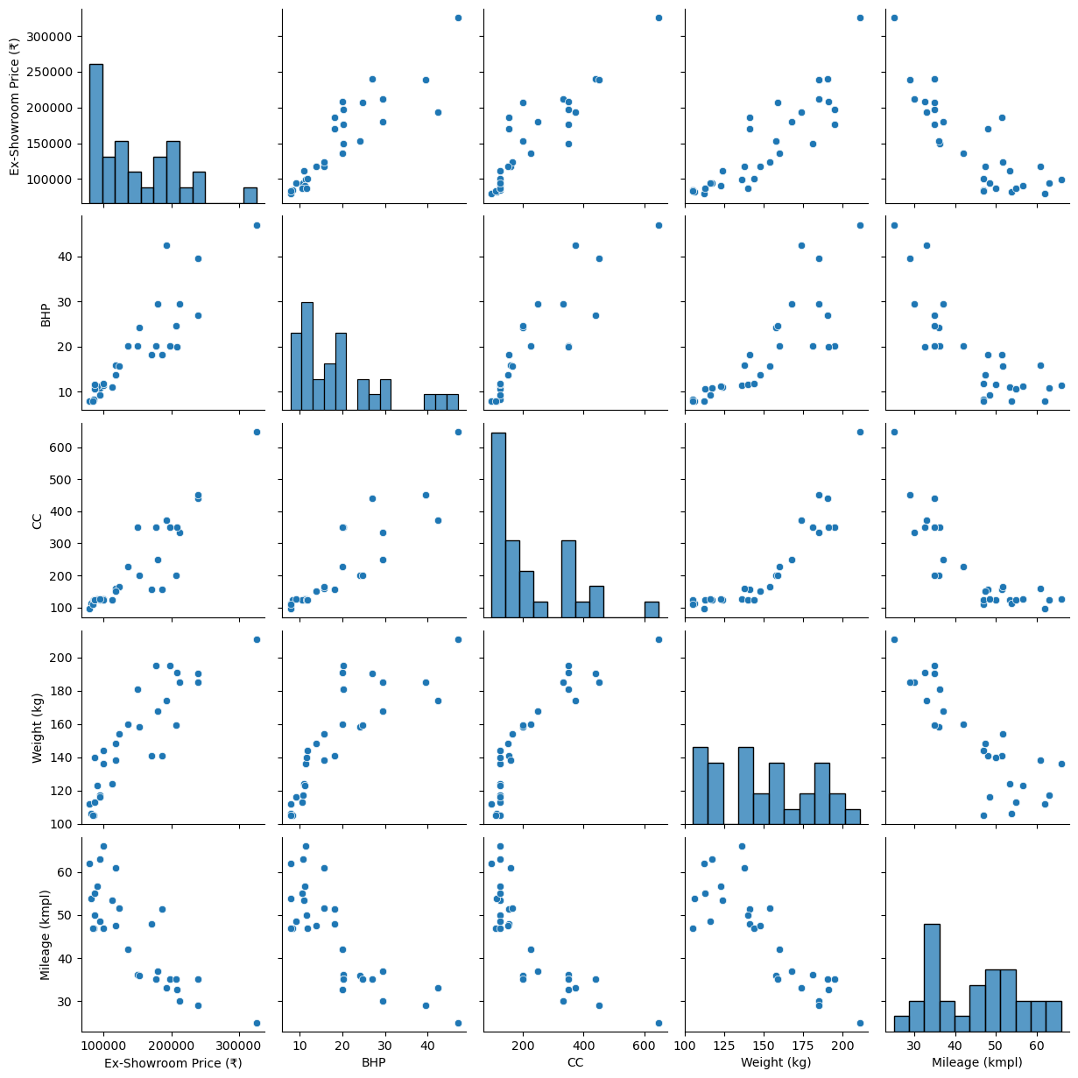
Comprehensive Feature Analysis
Pair Plot of Key Bike Features
Ex-Showroom Price has a positive correlation with BHP, CC, and Weight — more powerful and heavier bikes tend to cost more.
BHP and CC show a strong positive relationship — higher engine capacity generally means higher power.
Mileage has a negative correlation with Price, BHP, CC, and Weight — powerful, heavy, and expensive bikes tend to have lower fuel efficiency.
Weight is moderately correlated with Price and CC — bigger engines usually mean heavier bikes.

Slide 14
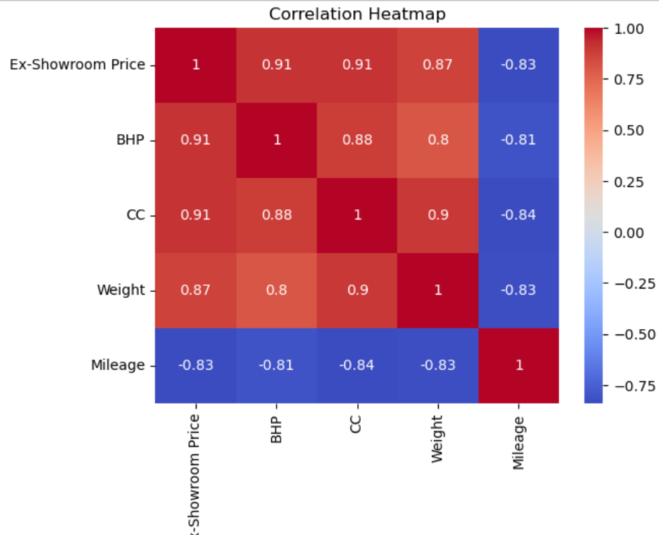
Feature Correlation Heatmap: Interconnections Revealed
This heatmap offers a powerful visualization of the correlation coefficients between the key numerical features of the bikes in our dataset. The color intensity and hue provide immediate insights into these relationships:
Red squares indicate a strong positive correlation, clearly visible between 'Price', 'BHP', and 'CC'. This suggests that higher engine capacity and power generally lead to higher prices.
Blue squares highlight a strong negative correlation, notably between 'Mileage' and all other features. This reinforces the earlier observation that increased engine size, power, and price tend to correspond with lower fuel efficiency.

Slide 15
Conclusion
This comprehensive exploratory data analysis of the Indian bike market, using data scraped from BikeWale.com, reveals several key industry trends and consumer choice factors. The most definitive finding, confirmed by the correlation heatmap, is the strong positive relationship between a bike's price, its engine capacity (CC), and its power output (BHP). This indicates a clear market structure where higher performance directly commands a premium price. Conversely, there is a significant and expected trade-off between performance and fuel efficiency, as mileage shows a strong negative correlation with these power-related features. The market is also distinctly segmented, with the distribution plots showing a large concentration of bikes in the 100-200cc commuter category, alongside another significant cluster in the 300-400cc lifestyle segment. In terms of brand presence among the top models, manufacturers like Royal Enfield, Bajaj, TVS, and Honda hold significant shares, demonstrating their strong footing across these different market segments. Ultimately, the analysis paints a clear picture of a market where consumers must balance the desire for performance against the practical need for fuel economy, a decision heavily influenced by price.

Slide 16

THANK YOU

